Slide 1
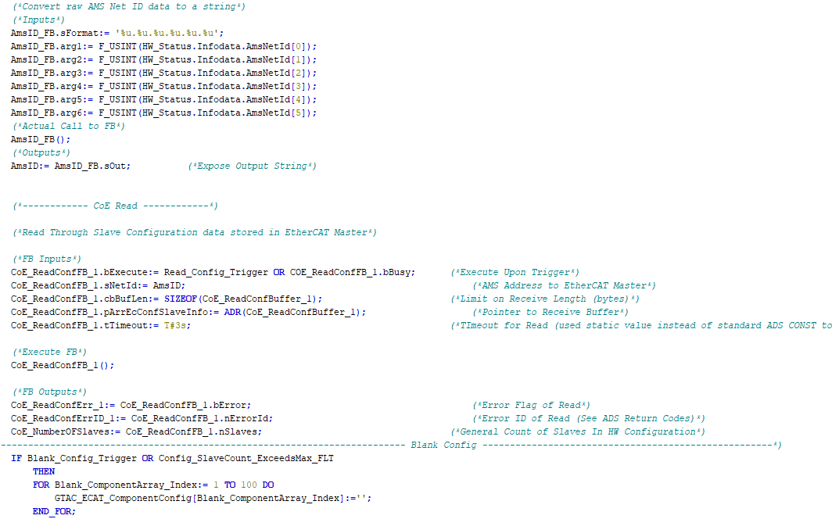

Internal Training:
PLC and UI Conventions

Slide 2
Intro
The goal of this power point presentation is to set some common conventions such as code style and layout, UI style and coloring as well as explain some standardized sections. Of our PLC and UI packages.
Although we do like to promote creativity, setting some boundaries helps to ensure consistency, code portability and easier adoption from programmer to programmer.

Slide 3
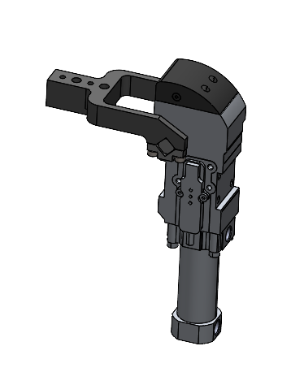
Clamp Steps

Slide 4
Clamp Steps
Clamps steps are where we carve out the general clamping and unclamping sequence of our fixtures, we then use the end result of the clamp step code to trigger valve banks associated with clamp groups.
As you may be familiar, the concept of clamp steps have been a widely debated topic for many years at our company. The current general practice is, clamp step style of code is highly suggested on fixtures that have more then 1 clamp / unclamp step. If only one step is required, then the clamp step style may be ignored, and the valve bank code can be triggered with Auto_Run and Weld_Complete (or other Completes as required for the application) directly.

Slide 5
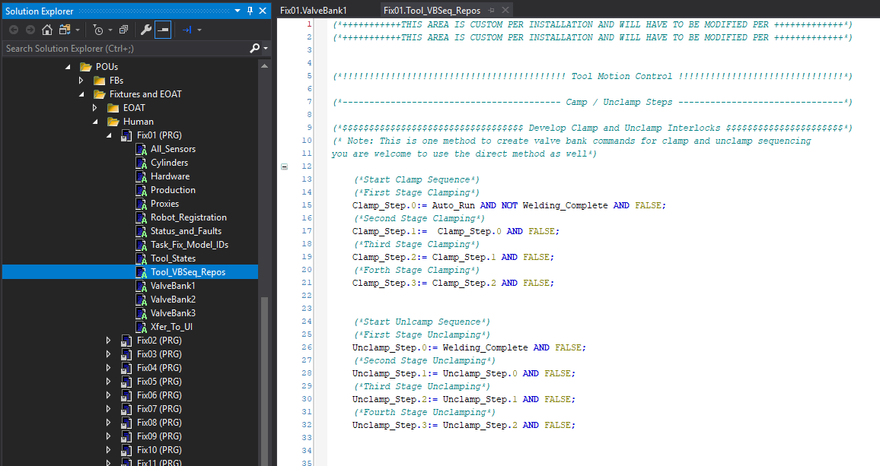
Clamp Steps
This is what the clamp step code looks like in our current (SSCC610) FW out of the box:

Slide 6
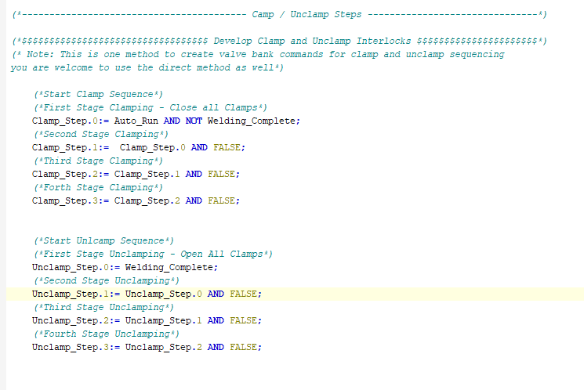
Clamp Steps
If our application used a very simple one step clamp / unclamp sequence, we could use the code as is with a few minor changes.
Comment the clamp / unclamp steps.
Remove the False variables in the clamp and unclamp steps.
Add the clamp and unclamp triggers to our valve bank code. (Next Slide)

Slide 7
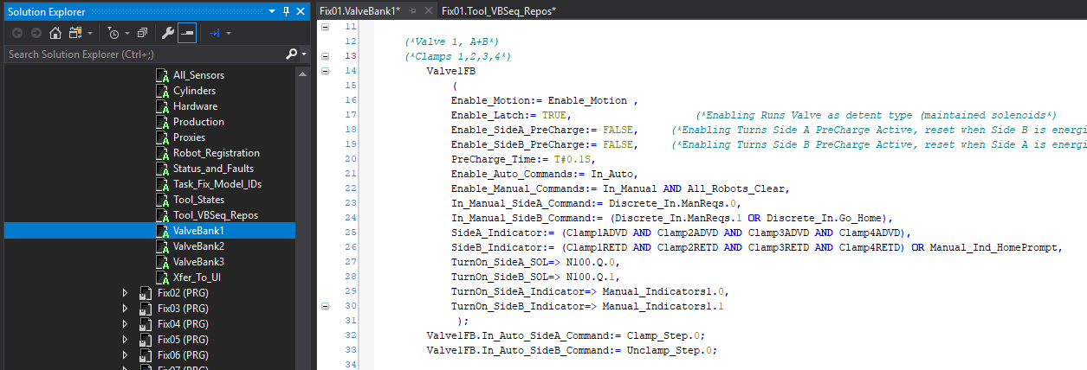
Clamp Steps
From previous slide:
Comment the clamp / unclamp steps.
Remove the False variables in the clamp and unclamp steps.
Add the clamp and unclamp triggers to our valve bank code.

Slide 8
Clamp Steps
Easy right?
In this next example, we will add a secondary step to the sequence.
Our application criteria will be as follows:
Clamping Sequence:
First Step = Send Clamp#3 to work
Second Step = Send Clamp#1,2,4 to work
Un-Clamping Sequence:
First Step = Send Clamp#3 to home
Second Step = Send Clamp#1,2,4 to home
Valving:
Valve#1 is plumbed to clamps 1,2,4
Valve#2 is plumbed to clamp 3

Slide 9
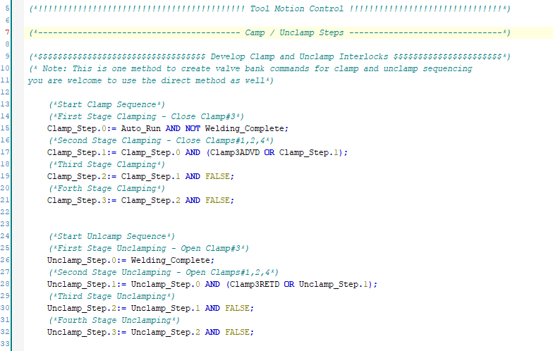
Clamp Steps
For the scenario, here is the clamp step code:

Slide 10
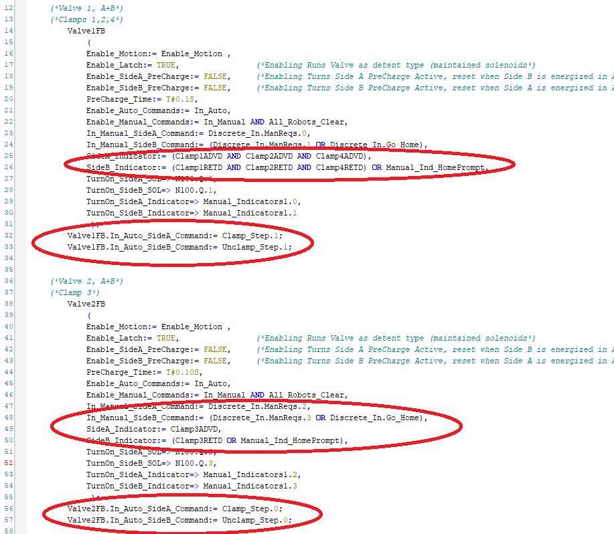
Clamp Steps
And this is the code for the valving:

Slide 11


TwinSAFE I/F

Slide 12

TwinSAFE I/F
You may have noticed we have a standardized interface for sending and gathering information to and from TwinSAFE based safety devices
SGs_RUNSTOP (bool)
SGs_ERRAck (bool)
FBs_ControlPowerPB (bool)
FBs_Restart_Spare (bool)
SGs_FB_ERR (byte)
SGs_COM_ERR (byte)
TwinSAFE
PLC
SGs_OUT_ERR (byte)
FBs_FB_ERR (dint)

Slide 13
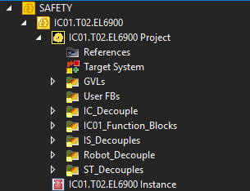
TwinSAFE I/F
Before we explore each signal, we should have a look at our standardized break down of a TwinSAFE safety project into Safety Groups
Primary Safety Group:
Contains the bulk of linking and all safety code for the component (IC01 in this case)
Decoupler Safety Groups:
Contain communication decoupling between the component at hand (IC01) and other components it must communicate with (other ICs, Robots, STs IS)
We break up our Safey code to separate logical “Safety Groups” so that a failure in one safety group doesn’t result in the entire safety project from halting.

Slide 14
TwinSAFE I/F
Let’s explore what each is used for. We will start with signals sent from the PLC to the Safety System
SGs_RUNSTOP (bool):
This is a simply bit used to set each Safety Group into Run. There is nothing fancy going on here. In the PLC code, these bits are set to True. Meaning , if the PLC is running, the safety group is also set to RUN
These are multi linked to every Safety Group in the applicable Safety Project.
SGs_ERRAck (bool):
This is a bit which is used to reset safety group level errors. In general, it is mapped to the Control Power PB by default BUT can be changed according to the applications needs for reset timing.
These are multi linked to every Safety Group in the applicable Safety Project.
FBs_ControlPowerPB (bool):
This is a fixed signal, tied to our UI Control Power Pushbutton, used to reset FB level monitoring. Examples of this are to reset Estop Function Blocks.
These are linked to any applicable FBs requiring monitoring reset, where the Control Power PB is applicable as a reset method.
FBs_Restart_Spare (bool):
This is a spare signal that can be mapped in the PLC to have other Push buttons used as a FB level reset. An example might be a specific zone in a machine that is only visible by one UI, in which case a global Control Power PB reset may not be best.
These are only used in applications requiring a specific scenario such as described.

Slide 15
TwinSAFE I/F
Now let’s take a look at signals sent to the PLC from the Safety System
SGs_FB_ERR (byte):
Each Bit in this signal’s byte is linked to a safety group’s “FB Error” group signal. So, for example, the Safety Systems Primary safety group, which contains it’s safety code, would be linked to bit 0. Subsequent decoupler safety groups are linked to bits 1, 2 and so on.
The linking map for each GTAC component type (IC, IS etc) can be found, as comments, in the TwnSAFE area of PLC’s fault code.
SGs_COMM_ERR (byte):
Again, each bit in this signal’s byte is linked to a safety groups “COMM Error”.
Bit 0 is always linked to the primary safety group, meaning bit 0 represents a comm error between the safety processor and a terminal local to the component. All subsequent bits are linked to decoupler safety groups.
Again, the linking map can be found in the fault section of our PLC code.
SGs_OUT_ERR (byte):
You’re likely now seeing the pattern for these Safety group signals. As with the previous two, bit 0 is always linked to the primary safety group and the remaining bits re linked to subsequent decoupler groups.
Once again, mapping legends can be found in the TwinSAFE area of the PLC fault code.
FBs_FB_ERR (dint):
These bits are used to link directly to specific FBs inside the safety project. Each bit represents a specific FB error. For example, in IC type components, bit 0 is used to link to the IC internal Estop FB. Meaing, if that bit is on, there is an issue with the safety processing of Estops of the IC.
As before, mapping is specific to each component, and the mapping legend for each is kept in the fault code commenting.

Slide 16
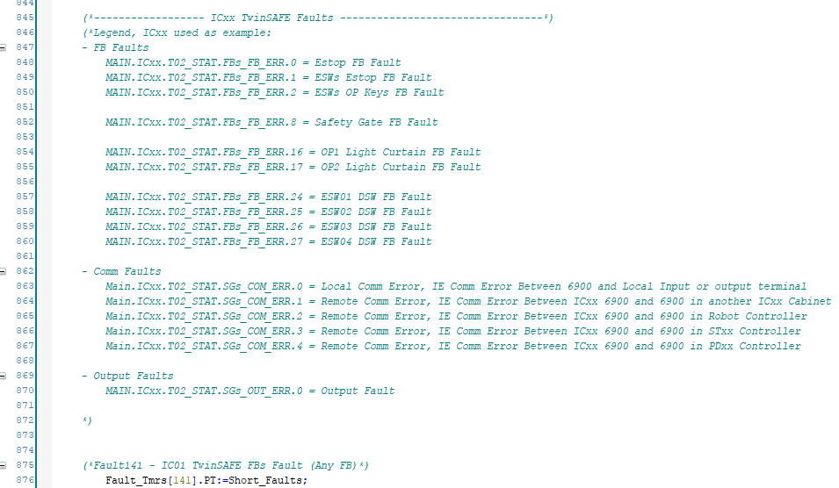
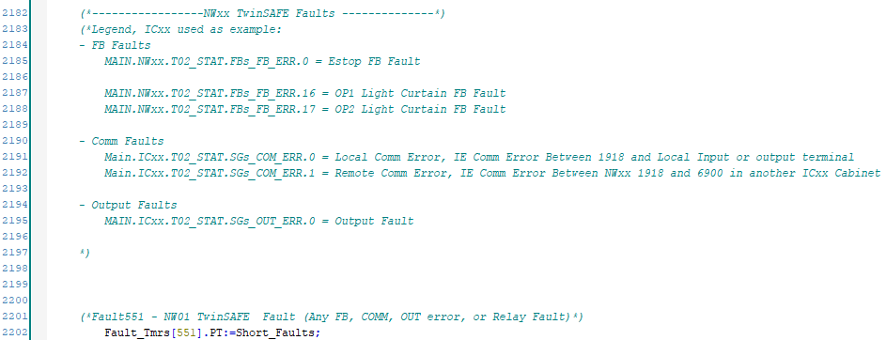
TwinSAFE I/F
Some examples of the mapping legends mentioned in the previous two slides

Slide 17
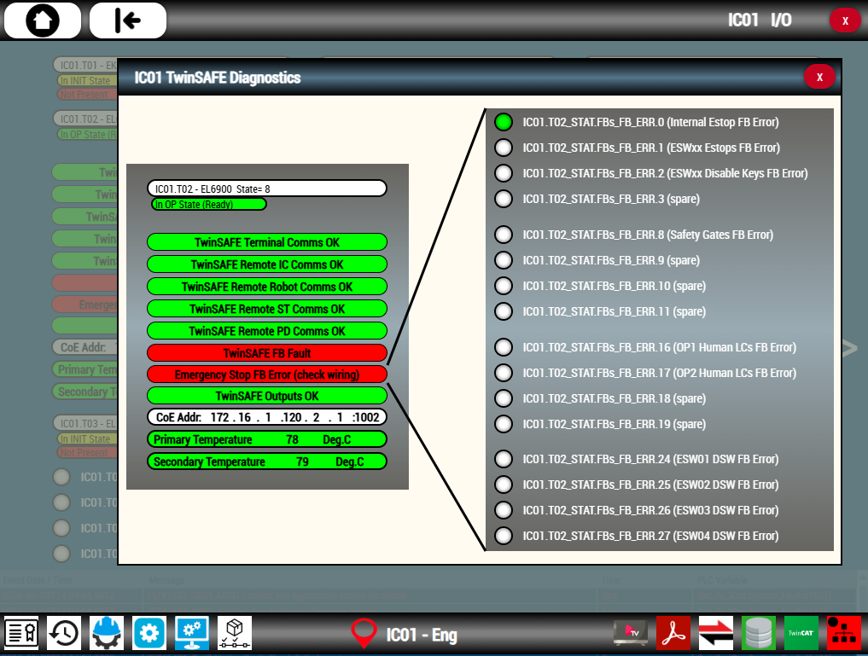
TwinSAFE I/F
The end result of all this TwinSAFE data is visualized on the TwinSAFE diagnostics screen of any GTAC component containing a TwinSAFE Processor (EL6900, EL1918). Shown below is ICxx with a simulated Estop FB error.

Slide 18

Thanks for your time

